Slide 1
Annual Members vs. Casual Riders Cyclistic Bike Trip Data for 2022
Analysis by Nikolas Rojas
Last updated: 01/28/2023

Slide 2
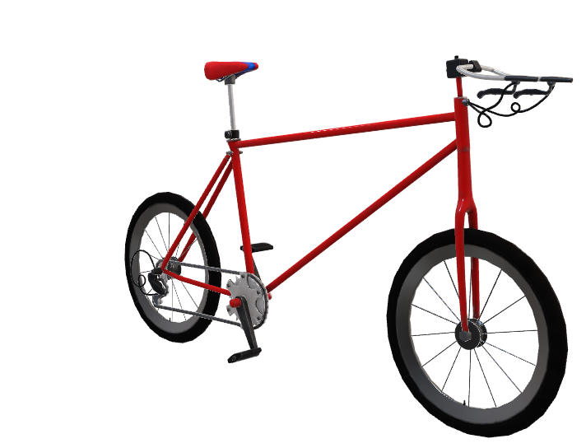
Objective
Determine how annual members and casual riders use Cyclistic bikes differently
Uncover trends to assist in the decision on how to convert casual riders to annual members

Slide 3
Data Sourced
The data used within this presentation was provided by the Cyclistic Bike company
The data was broken down into 12 individual spread sheets based on their respective months
Being that the data was provided directly from the company it is assumed to be reliable and was reviewed to be unbiased
The data was cleaned of any anomalies or null values using BigQuery SQL
Visuals have been procured using Tableau
Data Source

Slide 4
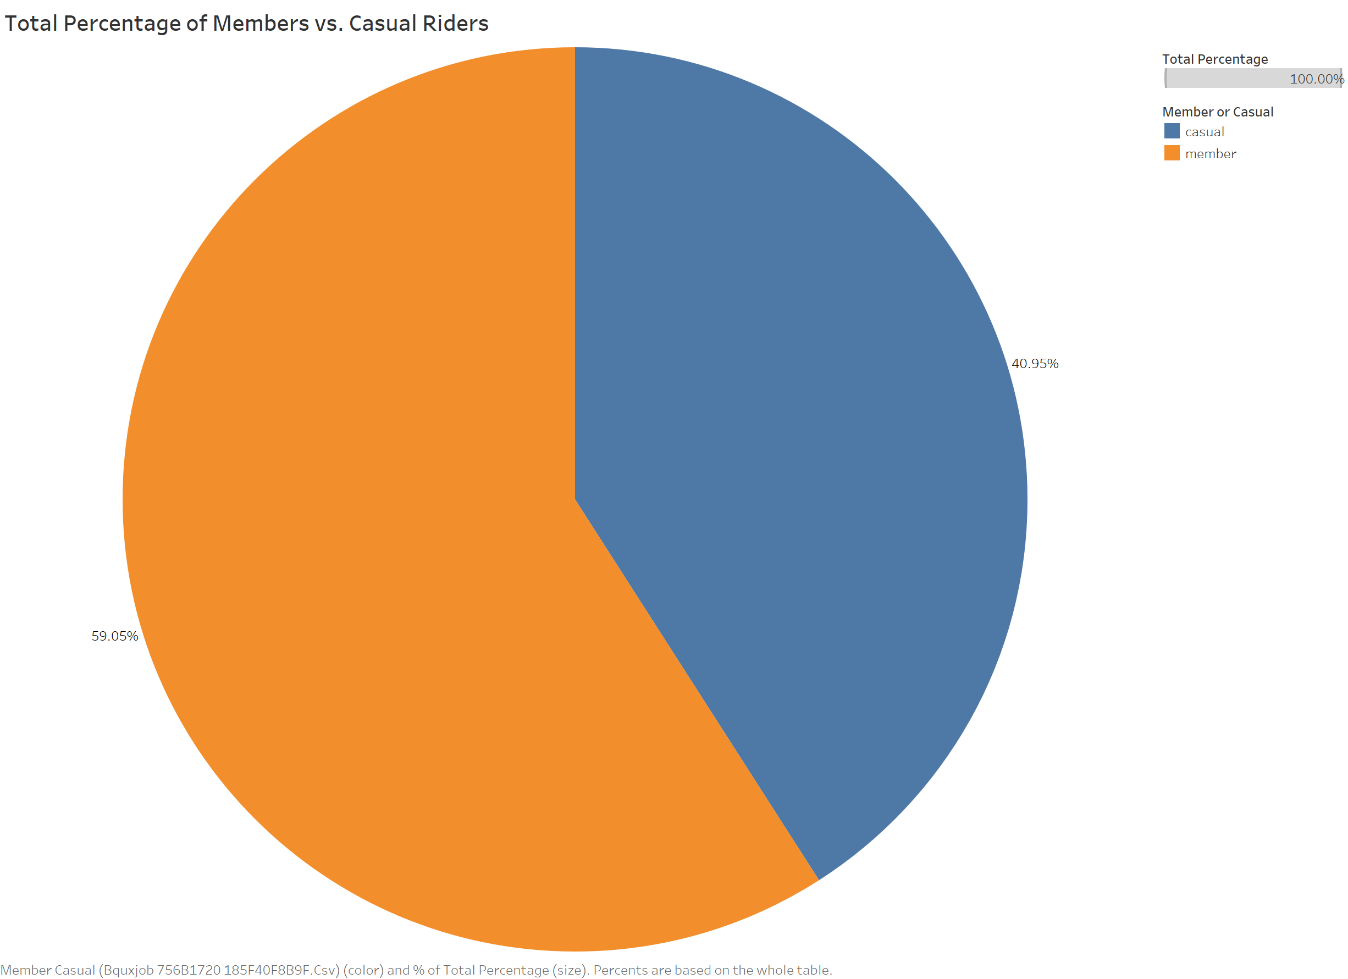
Total Percentage of Members VS. Casual Riders
Key Points
40.95% of the total trips in 2022 were made by casual riders
The remaining 59.05% of the trips were made by annual members

Slide 5
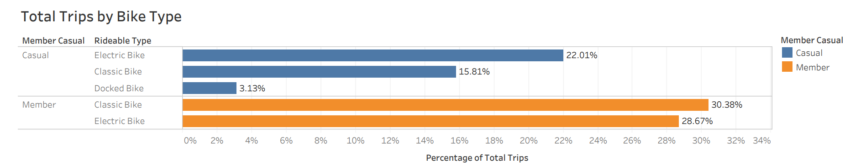
Percentage of Total Trips by Bike Type
Key Points
For Members, the Classic Bike is the most popular bike type
For Casual riders, the Electric Bike is the most popular bike type by far
It appears as if Members have NOT use the Docked Bike in 2022
Docked Bikes only make up a total of 3.13% of the total trips taken in 2022

Slide 6
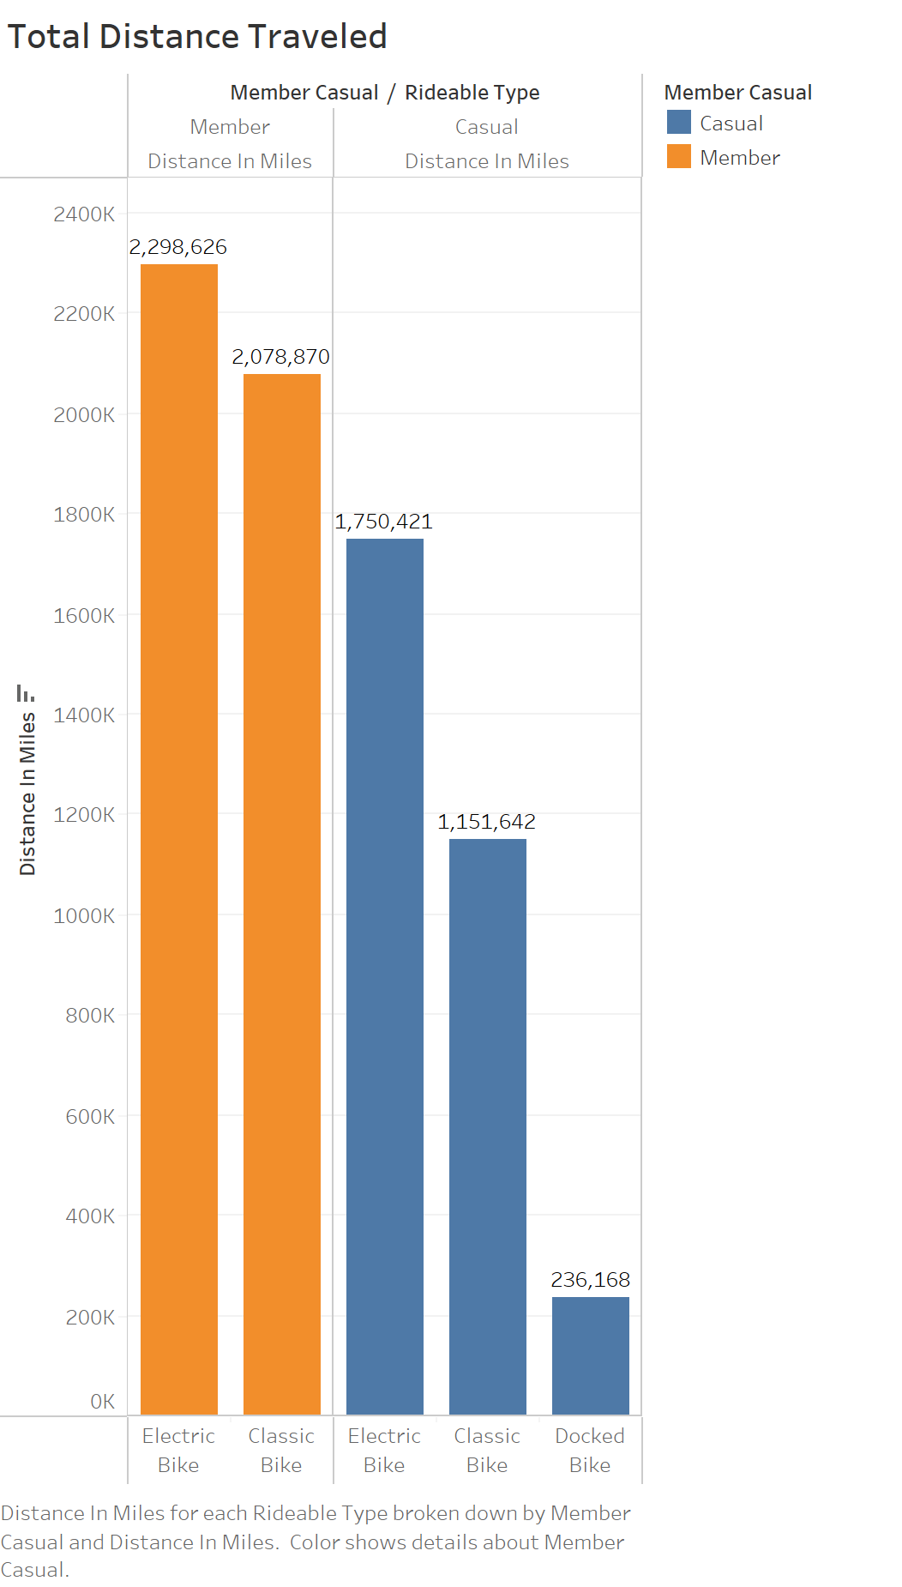
Distance Traveled by Each Bike Type
Key Points
When it comes to distance traveled it is clear that the Electric Bike is the bike of choice for both Members and Casual riders
The Docked Bike is used to go a fraction of the distance compared to the other bike types

Slide 7
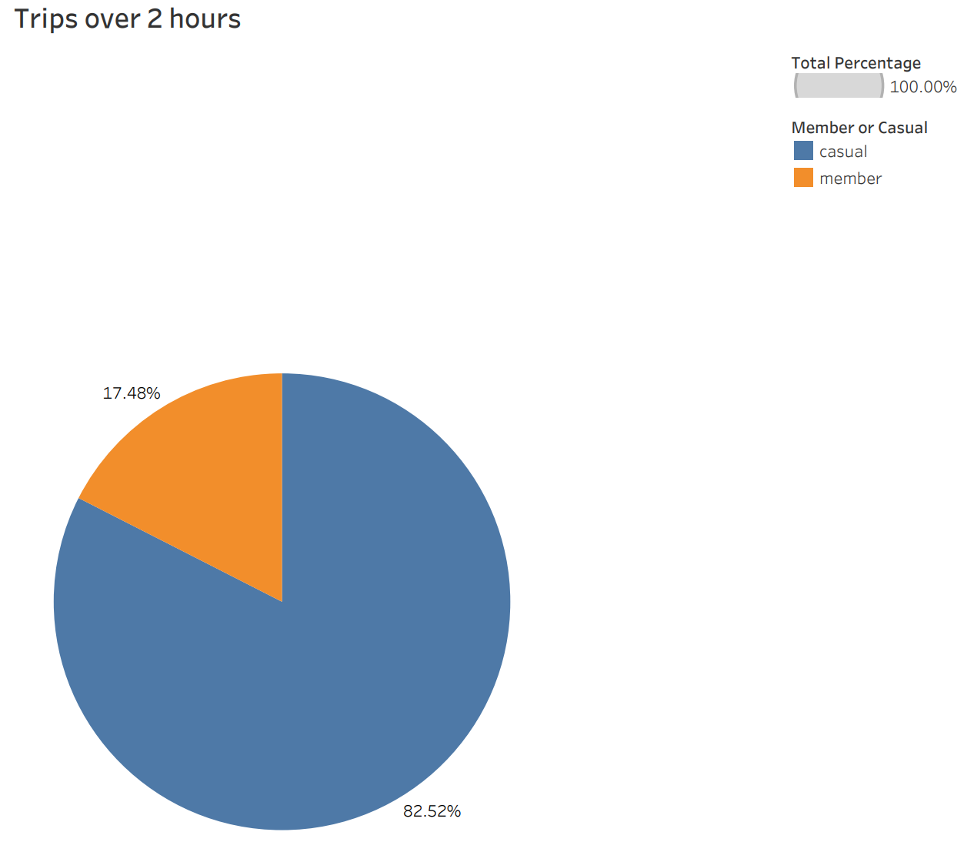
Percentage of Trips Over 2 hours
Key Points
More than 80% of all the trips over 2 hours long, were completed by casual riders
Only a small portion, less than 20% of trips over 2 hours long, were completed by annual members

Slide 8
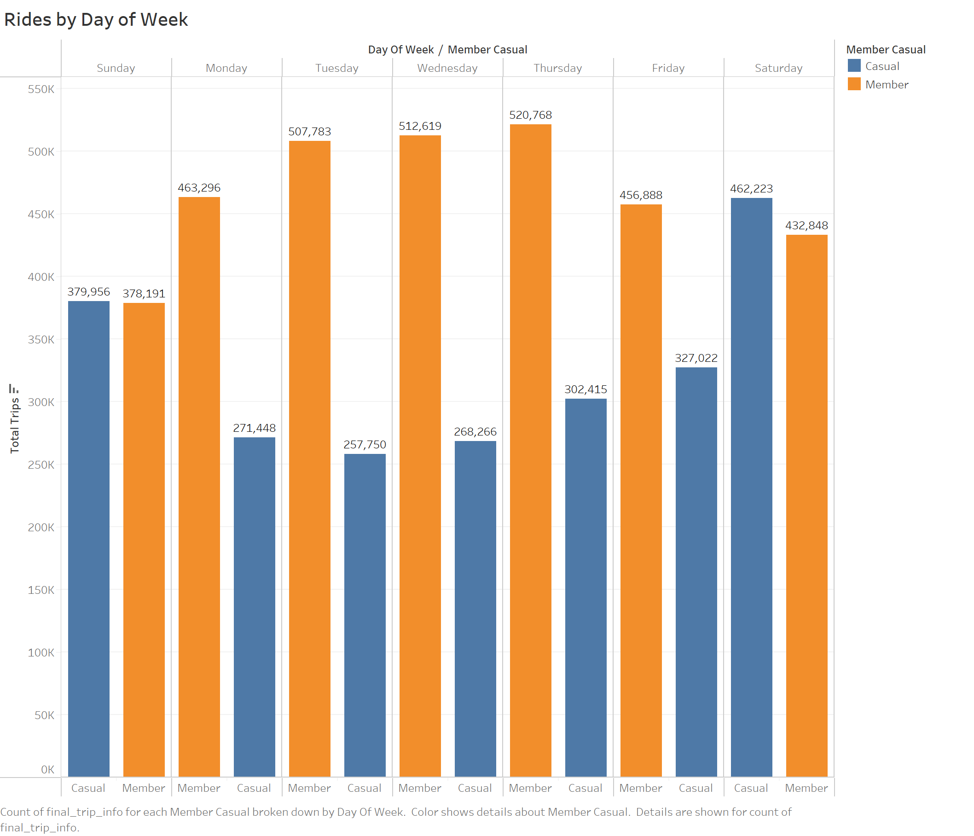
Trips by Day of the Week
Key Points
For Members, usage of Cyclistic Bikes remains consistent throughout the entire week
For Casual riders, their usage is at its peak during the weekend, specifically Saturday
The most popular days in the week for Members appear to be Monday through Friday

Slide 9
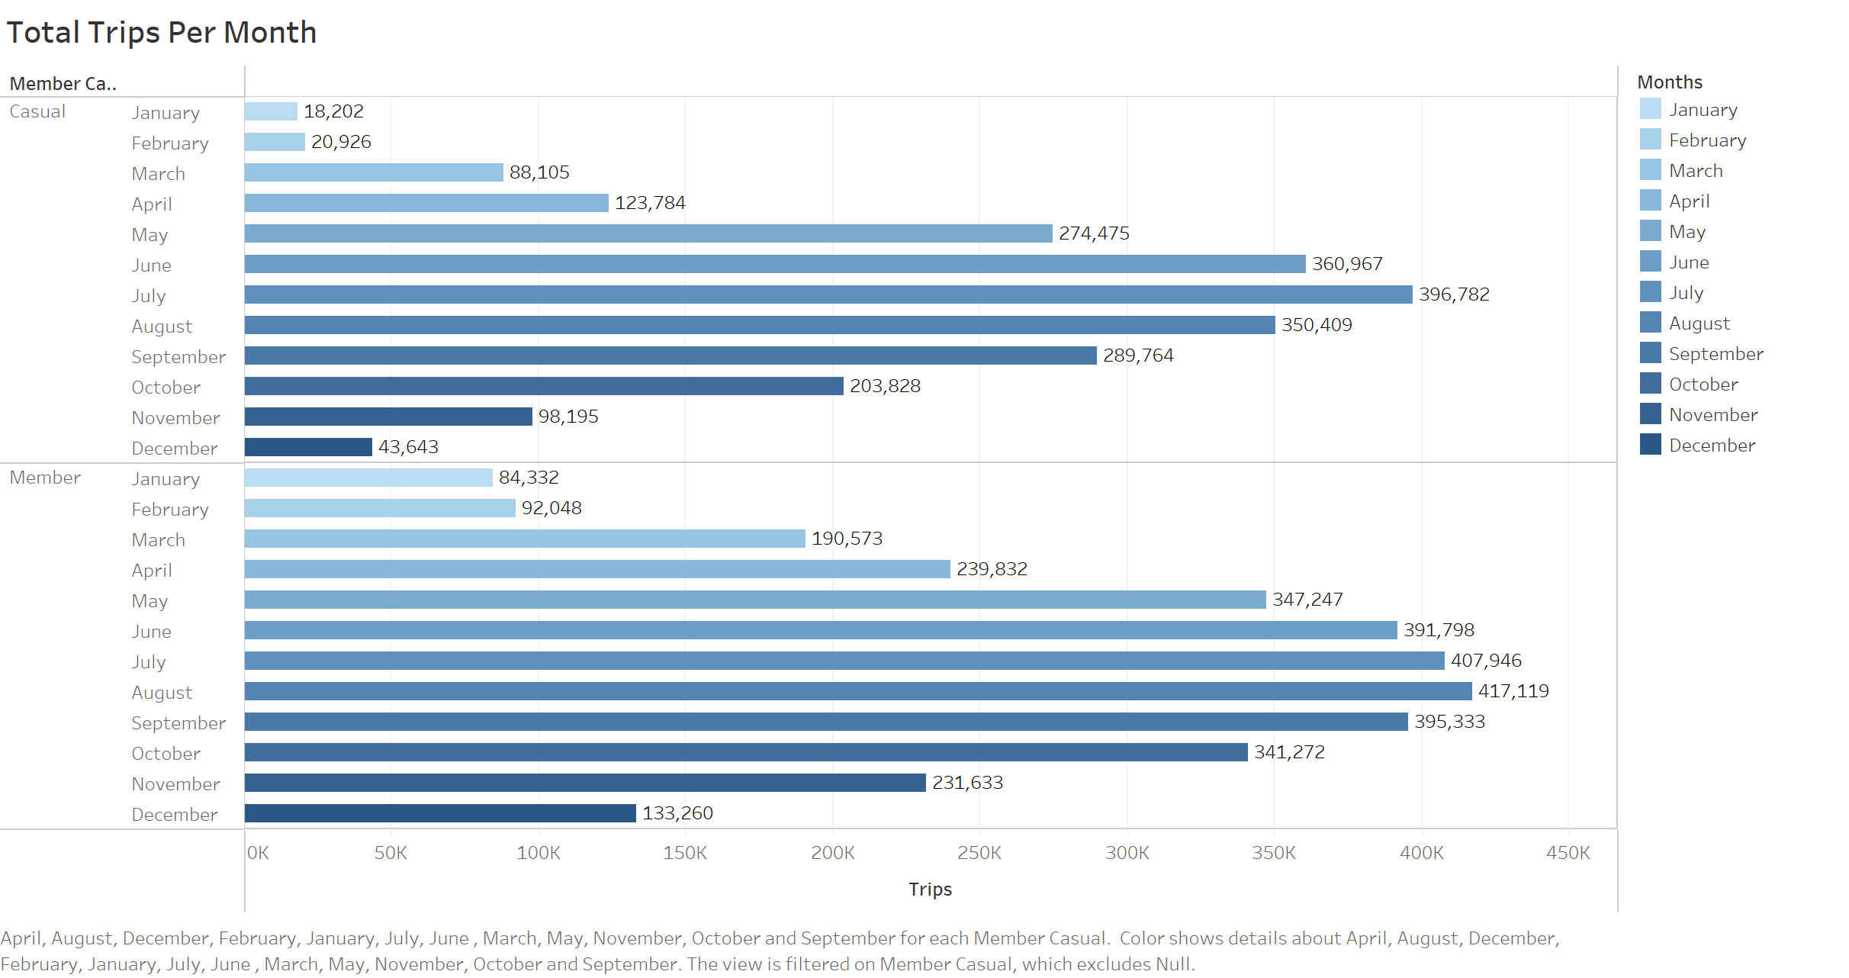
Number of Trips Taken Each Month
Key Points
January and February are the slowest for both members and casual riders
Summer months are the most popular for bike usage amongst both casual riders and annual members
July is the peak month for casual riders
August is the peak month for members

Slide 10


Key Observations
Recommendations
The Docked Bike is not a very popular bike choice
Casual riders are most active during the weekend
Summer months are most popular times of the year
Casual riders prefer the Electric Bike type and is well liked by members as well
Casual riders make more trips over 1 hour than annual members do
Primary focus is marketing Electric and Classic Bike types
Target ad campaigns towards individuals who use the bikes more on weekends; offer a discounted rate on the weekends for members only
Run the ad campaigns in the months leading up the summer as well as maybe one month into summer to increase likelihood of conversion
Advertise lower rates for Electric Bikes for members only on all
Offer promotion aimed at encouraging longer bike rides and better rates for members especially if ride time is over 1 hour, this will increase bike usage and conversion

